Slide 1
Modern Systems What Are FPGAs and Why Should You Care
Slides adapted from: Sang-Woo Jun, UCI
FPGA Workshop 3-4 June, Dr. Muhammad Yasin

Slide 2
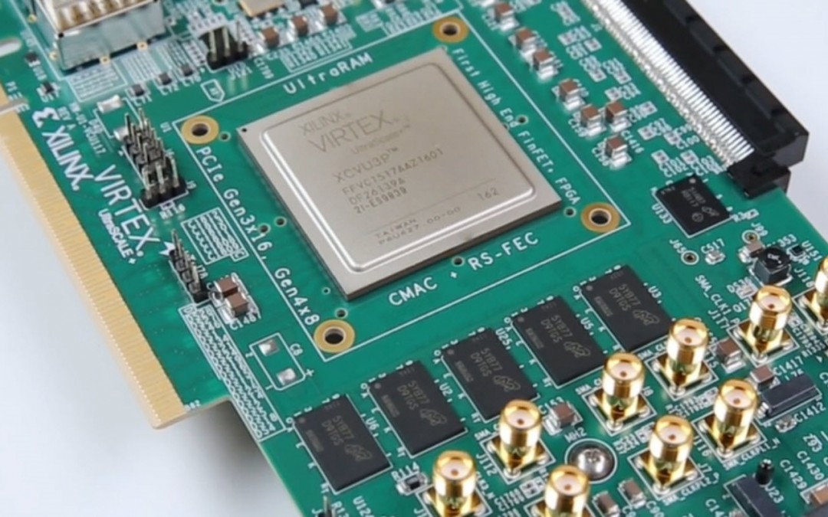
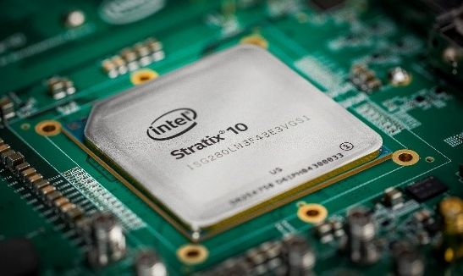
What Are FPGAs
Field-Programmable Gate Array
Can be configured to act like any circuit – More later!
Can do many things, but we focus on computation acceleration

Slide 3
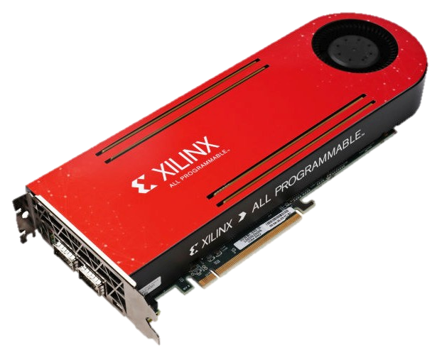
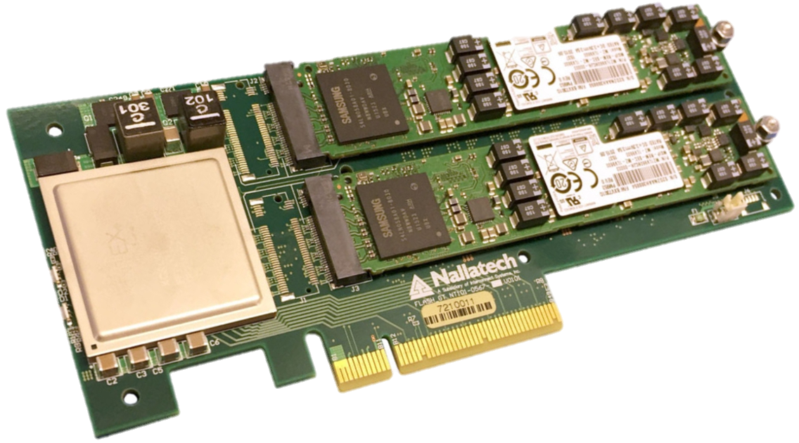
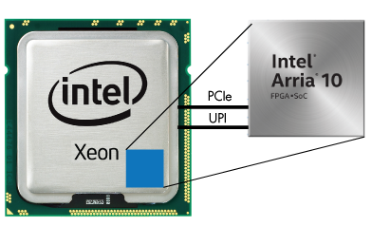
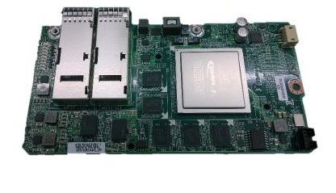
FPGAs Come In Many Forms
PCIe-Attached
In-Storage
CPU Integrated
In-Network

Slide 4
How Is It Different From CPU/GPUs
GPU – The other major accelerator
CPU/GPU hardware is fixed
“General purpose”
we write programs (sequence of instructions) for them
FPGA hardware is not fixed
“Special purpose”
Hardware can be whatever we want
Will our hardware require/support software? Maybe!
Optimized hardware is very efficient
GPU-level performance**
10x power efficiency (300 W vs 30 W)

Slide 5
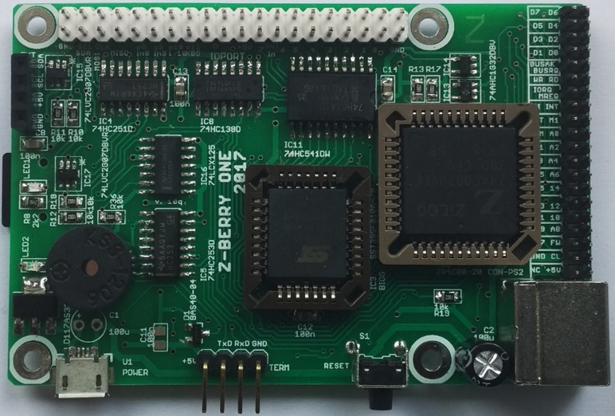
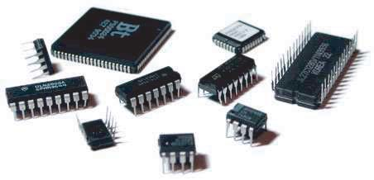
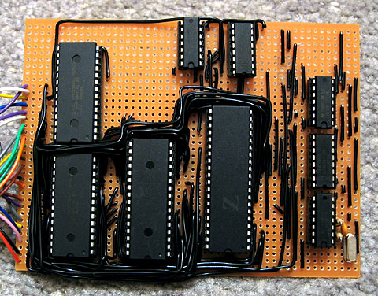
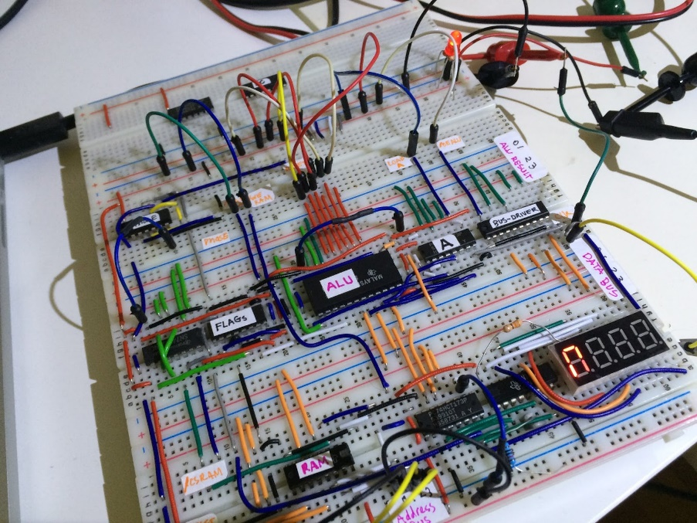
Analogy
CPU/GPU comes with fixed circuits
FPGA gives you a big bag of components
To build whatever
Could be a CPU/GPU!
“The Z-Berry”
“Experimental Investigations on Radiation Characteristics of IC Chips”
benryves.com “Z80 Computer”
Shadi Soundation: Homebrew 4 bit CPU

Slide 6
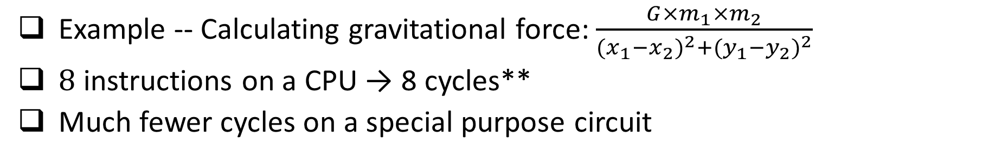
Fine-Grained Parallelism of Special-Purpose Circuits
Example -- Calculating gravitational force: $\frac{G×m_{1}×m_{2}}{{(x_{1}−x_{2})}^{2}+{(y_{1}−y_{2})}^{2}}$
8 instructions on a CPU → 8 cycles**
Much fewer cycles on a special purpose circuit
A = G × m₁ × m₂
B = (x₁ - x₂)²
C = (y₁ - y₂)²
A = G × m₁
C = x₁ - x₂
E = y₁ - y₂
D = B + C
B = A × m₂
D = C²
F = E²
Ret = B / G
G = D + F
3 cycles with compound operations
Ret = B / G
May slow down clock
Ret = (G × m₁ × m₂) / ((x₁ - x₂)² + (y₁ - y₂)²)
4 cycles with basic operations
1 cycle with even further compound operations

Slide 7
Coarse-Grained Parallelism of Special-Purpose Circuits
Typical unit of parallelism for general-purpose units are threads ~= cores
Special-purpose processing units can also be replicated for parallelism
Large, complex processing units: Few can fit in chip
Small, simple processing units: Many can fit in chip
Only generates hardware useful for the application
Instruction? Decoding? Cache? Coherence?

Slide 8
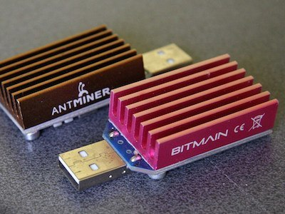
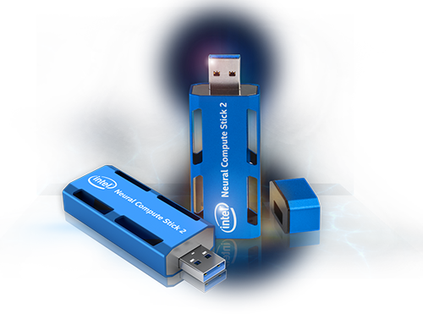
How Is It Different From ASICs
ASIC (Application-Specific Integrated Circuit)
Special chip purpose-built for an application
E.g., ASIC bitcoin miner, Intel neural network accelerator
Function cannot be changed once expensively built
+ FPGAs can be field-programmed
Function can be changed completely whenever
FPGA fabric emulates custom circuits
- Emulated circuits are not as efficient as bare-metal
~10x performance (larger circuits, faster clock)
~10x power efficiency

Slide 9
Basic FPGA Architecture
“Configurable logic block (CLB)”
Programmable
~
I/O block
6-Input
Look-Up
Table
Latch
FF
Ex) 2-LUT for “AND”
Input 1 | Input 2 | Output
0 | 0 | 0
0 | 1 | 0
1 | 0 | 0
1 | 1 | 1
Sequential circuit
construction
Programmable interconnect

Slide 10
Basic FPGA Architecture – DSP Blocks
“DSP block”
CLBs act as gates – Many needed to implement high-level logic
Arithmetic operation provided as efficient ALU blocks
“Digital Signal Processing (DSP) blocks”
Each block provides an adder + multiplier
×
+/-

Slide 11
Basic FPGA Architecture – Block RAM
“Block RAM”
CLB can act as flip-flops
(~1 bit/block) – tiny!
Some on-chip SRAM provided as blocks
~18/36 Kbit/block, MBs per chip
Massively parallel access to data → multi-TB/s bandwidth

Slide 12
Basic FPGA Architecture – Hard Cores
Some functions are provided as efficient, non-configurable “hard cores”
Multi-core ARM cores (“Zynq” series)
Multi-Gigabit Transceivers
PCIe/Ethernet PHY
Memory controllers
…
Memory
Ethernet
ARM
PCIe

Slide 13
Example Accelerator Card Architecture
“FPGA Mezzanine Card” Expansion
Network Ports, Memory, Storage, PCIe, …
General-Purpose I/O Pins
Multi-Gigabit Transceivers
FMC
FPGA
DRAM
1GbE
DRAM
40GbE
PCIe

Slide 14
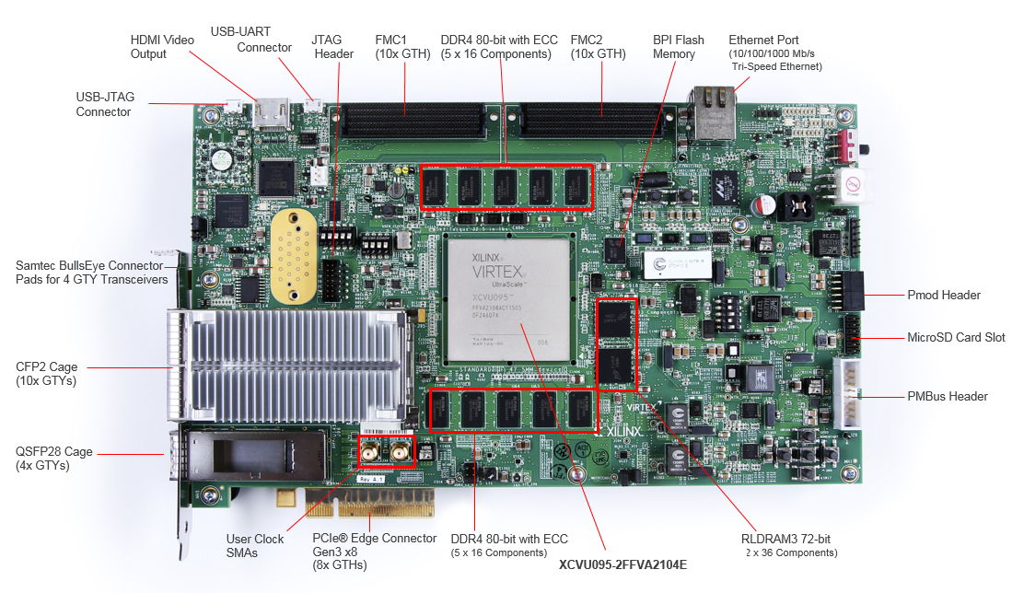
Example Accelerator Card (VCU108)

Slide 15
Programming FPGAs
Languages and tools overlap with ASIC/VLSI design
FPGAs for acceleration typically done with either
Hardware Description Languages (HDL): Register-Transfer Level (RTL) languages
High-Level Synthesis: Compiler translates software programming languages to RTL
RTL models a circuit using:
Registers (state), and
Combinational logic (computation)

Slide 16
Hardware Description Language
Software programming languages: Describes process
Hardware description languages: Describes structure
std::queue<float> input_queue;
std::queue<float> output_queue;
float factor;
while (true) {
if ( !input_queue.empty() ) {
ret = input_queue.front() * factor;
output_queue.push(ret)
input_queue.pop();
}
}
FIFO#(Float) input_queue <- mkFIFO;
FIFO#(Float) output_queue <- mkFIFO;
Reg#(Float) factor <- mkReg;
FloatMultIfc mult <- mkFloatMult;
rule in;
mult.enq(factor, input_queue.first);
input_queue.deq;
endrule
rule out;
ret <- mult.result;
output_queue.enq(ret);
endrule
Exists in memory
Exists on chip
Instructions
For CPU
Creates
circuits

Slide 17
Major Hardware Description Languages
Verilog: Most widely used in industry
Relatively low-level language supported by everyone
Chisel – Compiles to Verilog
Relatively high-level language from Berkeley
Embedded in the Scala programming language
Prominently used in RISC-V development (Rocket core, etc)
Bluespec – Compiles to Verilog
Relatively high-level language from MIT
Supports types, interfaces, etc
Also active RISC-V development (Piccolo, etc)

Slide 18
High-Level Synthesis
Compiler translates software programming languages to RTL
High-Level Synthesis compiler from Xilinx, Altera/Intel
Compiles C/C++, annotated with #pragma’s into RTL
Theory/history behind it is a complex can of worms we won’t go into
Personal experience: needs to be HEAVILY annotated to get performance
Anecdote: Naïve RISC-V in Vivado HLS achieves IPC of 0.0002 [1], 0.04 after optimizations [2]
OpenCL
Inherently parallel language more efficiently translated to hardware
Stable software interface
[1] http://msyksphinz.hatenablog.com/entry/2019/02/20/040000
[2] http://msyksphinz.hatenablog.com/entry/2019/02/27/040000

Slide 19
FPGA Compilation Toolchain
“Which transceiver instance should
top_transceiver_01 map to?”
And so, so much more…
High-Level
HDL Code
High-level language vendor tool
Constraint
File
Functional
Simulation
Cycle-level
Simulation
Language
Compiler
FPGA Vendor toolchain (Few open source)
Verilog/
VHDL
Netlist
Bitfile
Synthesize
Map/
Place/
Route

Slide 20
Programming/Using an FPGA Accelerator
Bitfile is programmed to FPGA over “JTAG” interface
Typically used over USB cable
Supports FPGA programming, limited debugging access, etc
PCIe-attached FPGA accelerator card is typically used similarly to GPUs
Program FPGA, execute software
Software copies data to FPGA board, notify FPGA -> FPGA logic performs computations -> Software copies data back from FPGA
FPGA flexibility gives immense freedom of usage patterns
Streaming, coherent memory, …

Slide 21
Partial Reconfiguration
FPGA
Sub-components
Parts of the FPGA can be swapped out dynamically without turning off FPGA
Physical area is drawn on chip
Used in Amazon F1, etc
Toolchain support for isolation

Slide 22
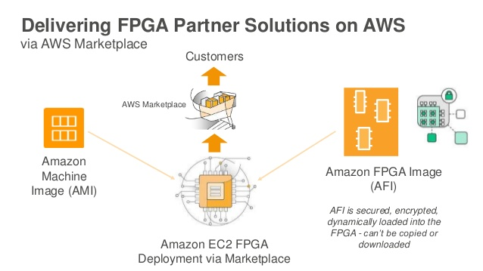
FPGAs In The Cloud
Amazon EC2 F1 instance (1 – 4 FPGAs)
Microsoft Azure, etc…

Slide 23
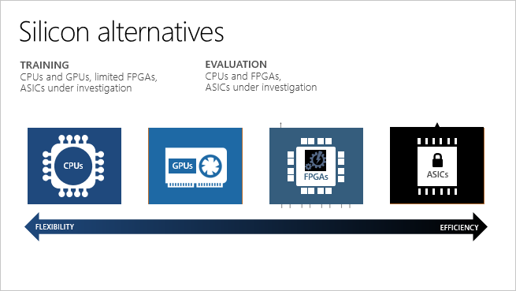
FPGA vs CPU vs GPU vs ASIC

Slide 24
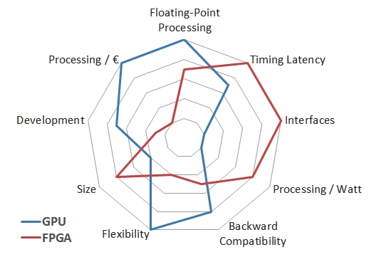
GPU vs FPGA

Slide 25
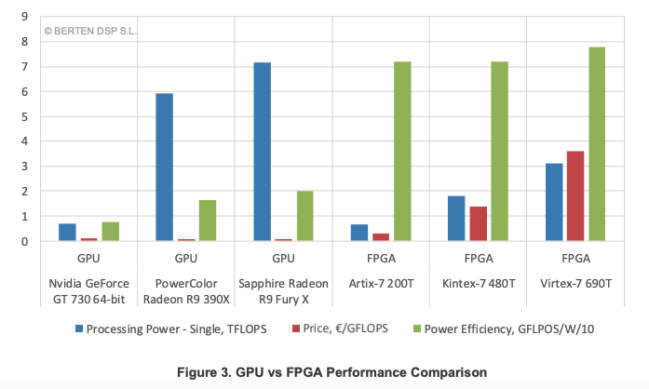
GPU vs FPGA
https://www.bertendsp.com/gpu-vs-fpga-performance-comparison/

Slide 26
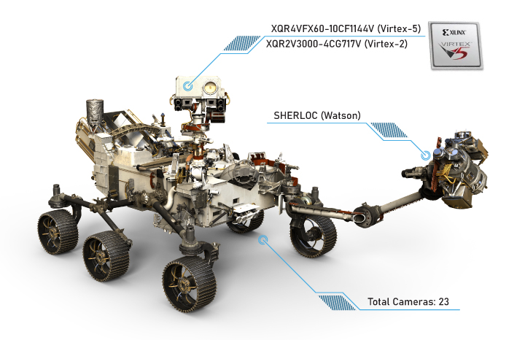
FPGAs in space

Slide 27

FPGAs in Defense
source: Xilinx Inc

Slide 28
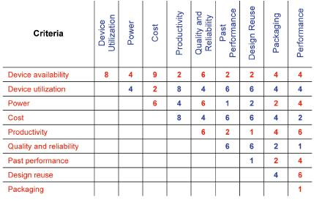
Selection criteria
https://www.mobilityengineeringtech.com/component/content/article/adt/pub/features/articles/6332

